Slide 1
Nonclassicality, quasiprobabilities and weak values explored in neutron interferometry
Ismaele Vincent Masiello
Neutron and Quantum Physics
Atominstitut
TU Wien, Austria

Slide 2
Motivation and goal
Quantum mechanics exhibits features with no classical counterpart.

Slide 3
Motivation and goal
Quantum mechanics exhibits features with no classical counterpart.
However, not all quantum experiments exhibit non-classical features and identifying the classical/quantum boundaries is of importance.

Slide 4
Motivation and goal
Quantum mechanics exhibits features with no classical counterpart.
However, not all quantum experiments exhibit non-classical features and identifying the classical/quantum boundaries is of importance.
We are interested in experimental tools to probe such boundaries.

Slide 5
Overview
Preparation-Measurement scenarios
Quasiprobability representations and weak values
Experimental results

Slide 6
Preparation-Measurement scenarios

Slide 7
Preparation-Measurement scenarios
Disclaimer: not all experiments are this simple

Slide 8
Preparation and Measurement
Preparation (P)
Measurement (M)
1
2
3
t
1
2
3
...
n
System
Outcome probabilities:

Slide 9
A classical experiment
Preparation (P)
Measurement (M)
1
2
3
...
n
System
Defined set of properties:

Slide 10
A classical experiment
Preparation (P)
Measurement (M)
1
2
3
...
n
System
Defined set of properties:

Slide 11
A classical experiment
Preparation (P)
Measurement (M)
1
2
3
...
n
100%
System
100%
Outcome probabilities:

Slide 12
A classical experiment
Preparation (P)
Measurement (M)
1
2
3
...
n
15%
75%
10%
System
75%
25%

Slide 13
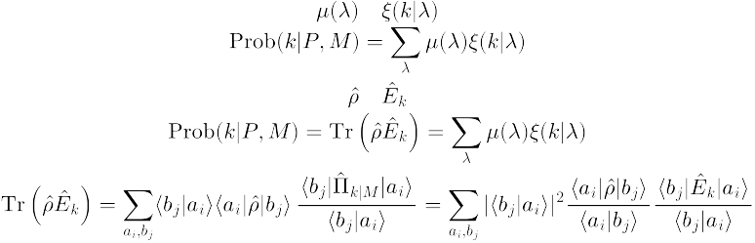
A classical experiment
Probability distribution:
Response function:
Preparation (P)
Measurement (M)
1
2
3
...
n
15%
75%
10%
System
75%
25%
Outcome probabilities:

Slide 14


A quantum experiment
Preparation (P)
Measurement (M)
1
2
3
...
n
System
Set of undefined properties:

Slide 15

A quantum experiment
Pure state:
Projective measurement:
Preparation (P)
Measurement (M)
1
2
3
...
n
System
100%

Slide 16

A quantum experiment
Pure state:
Projective measurement:
Preparation (P)
Measurement (M)
1
2
3
...
n
25%
75%
System
100%
Outcome probabilities:

Slide 17


A quantum experiment
Density matrix:
POVM element:
Preparation (P)
Measurement (M)
1
2
3
...
n
System
75%
25%

Slide 18
A quantum experiment
Density matrix:
POVM element:
Preparation (P)
Measurement (M)
1
2
3
...
n
System
75%
25%
Outcome probabilities:

Slide 19
Can my experiment be reproduced classically?

Slide 20
Can my experiment be reproduced classically?
Outcome probabilities:
?

Slide 21
Quasiprobability representations and weak values

Slide 22

Quasiprobability representations
Quasiprobability representations:

Slide 23
Quasiprobability representations
Quasiprobability representations:
Quasiprobability
distribution
Symbol

Slide 24
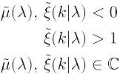
Quasiprobability representations
Quasiprobability representations:
Quasiprobability
distribution
Symbol
Anomalous features:
Ferrie, Christopher. "Quasi-probability representations of quantum theory with applications to quantum information science." Reports on Progress in Physics 74.11 (2011): 116001.

Slide 25
Quasiprobability representations
Two orthonormal basis:
Kirkwood-Dirac quasiprobability representation:

Slide 26
Quasiprobability representations
Two orthonormal basis:
Kirkwood-Dirac quasiprobability representation:
Weak value
..and we can measure it!

Slide 27
Quasiprobability representations
Two orthonormal basis:
Kirkwood-Dirac quasiprobability representation:
Weak values!
..and we can measure them!

Slide 28

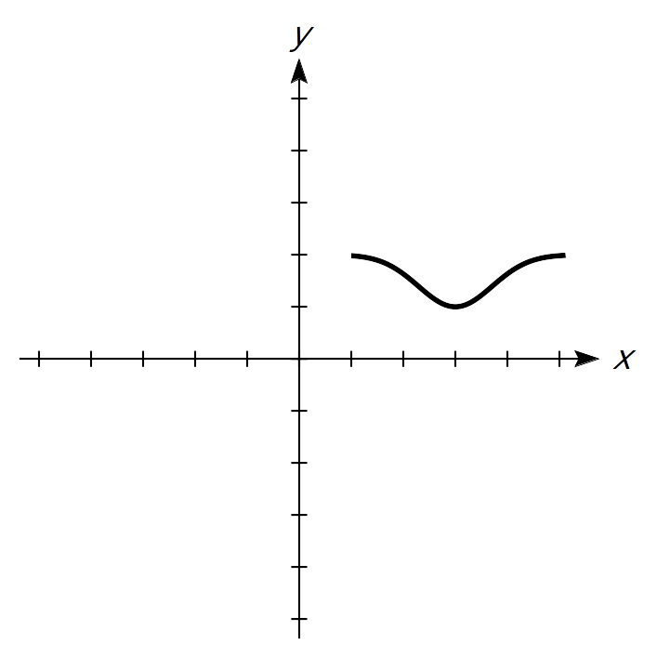
A standard (Von Neumann) measurement
Stern-Gerlach
∆t
Spin
Position
N
Interaction strength
S

Slide 29
A weak measurement
Spin
Position
Aharonov, Yakir, et al. "How the result of a measurement of a component of the spin of a spin-1/2 particle can turn out to be 100." Physical review letters 60.14 (1988): 1351.

Slide 30
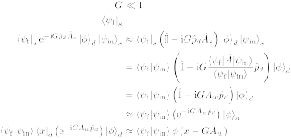
A weak measurement
Weak interaction
Spin
Position
N
S
Aharonov, Yakir, et al. "How the result of a measurement of a component of the spin of a spin-1/2 particle can turn out to be 100." Physical review letters 60.14 (1988): 1351.

Slide 31
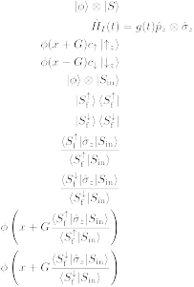
A weak measurement
Weak interaction
Spin
Position
N
Post-selection
N
S
S
Aharonov, Yakir, et al. "How the result of a measurement of a component of the spin of a spin-1/2 particle can turn out to be 100." Physical review letters 60.14 (1988): 1351.

Slide 32
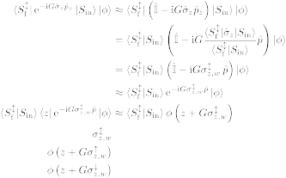

A weak measurement
Weak interaction
Spin
Position
N
Post-selection
N
S
S
Spin weak value:
Aharonov, Yakir, et al. "How the result of a measurement of a component of the spin of a spin-1/2 particle can turn out to be 100." Physical review letters 60.14 (1988): 1351.

Slide 33
Weak values extraction in neutron interferometry
Meter state and weak interaction:
Lemmel, Hartmut, et al. "Quantifying the presence of a neutron in the paths of an interferometer." Physical Review Research 4.2 (2022): 023075.
Danner, Armin, et al. "Simultaneous path weak-measurements in neutron interferometry." Scientific Reports 14.1 (2024): 25994.
Dvorak, Andreas, et al. "Tight qubit uncertainty relations studied through weak values in neutron interferometry." Physical Review Research 7.4 (2025): 043334.
Meter state and no weak interaction:
Denkmayr, Tobias, et al. "Weak values from strong interactions in neutron interferometry." Physica B: Condensed Matter 551 (2018): 339-346.
No meter state and weak interaction:
Masiello, Ismaele V., et al. "Simultaneous determination of two path weak-values with time-dependent phase manipulation in neutron interferometry." New Journal of Physics 27.2 (2025): 023017.

Slide 34
Weak values extraction in neutron interferometry
Meter state and weak interaction:
Lemmel, Hartmut, et al. "Quantifying the presence of a neutron in the paths of an interferometer." Physical Review Research 4.2 (2022): 023075.
Danner, Armin, et al. "Simultaneous path weak-measurements in neutron interferometry." Scientific Reports 14.1 (2024): 25994.
Dvorak, Andreas, et al. "Tight qubit uncertainty relations studied through weak values in neutron interferometry." Physical Review Research 7.4 (2025): 043334.
Meter state and no weak interaction:
Denkmayr, Tobias, et al. "Weak values from strong interactions in neutron interferometry." Physica B: Condensed Matter 551 (2018): 339-346.
No meter state and weak interaction:
Masiello, Ismaele V., et al. "Simultaneous determination of two path weak-values with time-dependent phase manipulation in neutron interferometry." New Journal of Physics 27.2 (2025): 023017.

Slide 35
Weak values extraction in neutron interferometry
Meter states or weak interactions increase
the experimental complexity!
The manipulation of additional degrees of freedom increases the amount of required experimental resources (additional instrumentation and procedures), while weak interactions typically necessitate longer measurement times due to the limited information gained per detection event.

Slide 36
Weak values extraction in neutron interferometry
Meter states or weak interactions increase
the experimental complexity!
The manipulation of additional degrees of freedom increases the amount of required experimental resources (additional instrumentation and procedures), while weak interactions typically necessitate longer measurement times due to the limited information gained per detection event.
No meter state and no weak interaction:
Masiello, Ismaele V., et al. "Anomalous weak values in a generalized Mach-Zehnder interferometer extracted directly from intensity measurements." arXiv:2606.24798v1 - in review at npj Quantum Information.

Slide 37
Experimental results

Slide 38

Neutron interferometry
Neutron Mach-Zehnder interferometer:

Slide 39




Neutron interferometry
Generalized neutron
Mach-Zehnder interferometer:
Neutron

Slide 40
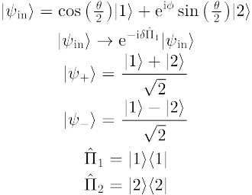
Weak values from output intensities
Initial state:
Generalized neutron
Mach-Zehnder interferometer:
Path observable:
2
1

Slide 41
Weak values from output intensities
Initial state:
Generalized neutron
Mach-Zehnder interferometer:
Path observable:
Phase shift:

Slide 42
Weak values from output intensities
Initial state:
Generalized neutron
Mach-Zehnder interferometer:
Path observable:
Phase shift:
-
+
Final states:

Slide 43
Weak values from output intensities
Initial state:
Generalized neutron
Mach-Zehnder interferometer:
Path observable:
Phase shift:
Final states:
Measured intensity:

Slide 44
Weak values from output intensities
Initial state:
Generalized neutron
Mach-Zehnder interferometer:
Path observable:
Phase shift:
Final states:
Measured intensity:

Slide 45
Neutron interferometry
Why neutron interferometry?
Interference is intrinsically a single-massive-particle phenomenon.
Matter-wave interferometry at room temperature and ambient pressure, with macroscopic beam separation and high contrast.
Manipulation of several degrees of freedom (path, spin, energy).
Sponar, S., Sedmik, R. I., Pitschmann, M., Abele, H. & Hasegawa, Y. Tests of fundamental quantum mechanics and dark interactions with low-energy neutrons. Nat. Rev. Phys. 3, 309–327 (2021).

Slide 46

Weak values from output intensities
Generalized neutron
Mach-Zehnder interferometer:
Weak values can be
directly extracted from
the output intensities!
Path weak-values:

Slide 47
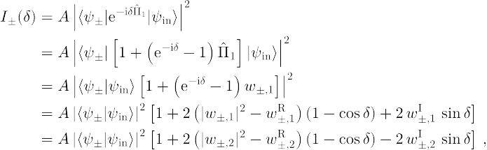
Weak values from output intensities
Measured intensity:
Amplitude
squared
Real
part
Imaginary
part

Slide 48
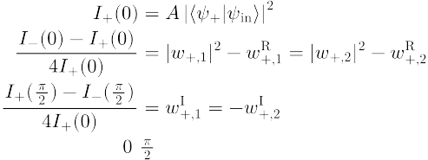

Weak values from output intensities
Three measurements settings:

Slide 49
Weak values from output intensities
Three measurements settings:

Slide 50
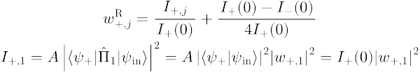
Weak values from output intensities
Three measurements settings:

Slide 51
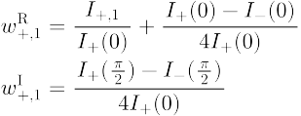
Weak values from output intensities
Weak value extraction:

Slide 52
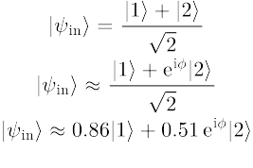
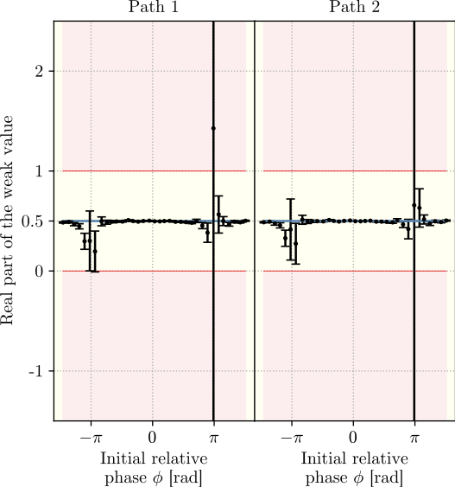
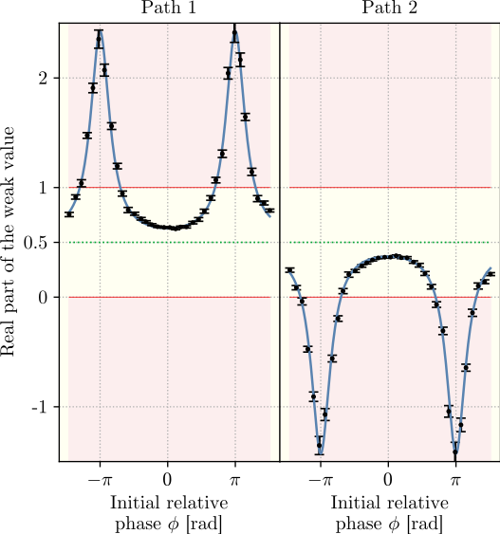
Weak values from output intensities
Balanced:
Unbalanced:

Slide 53
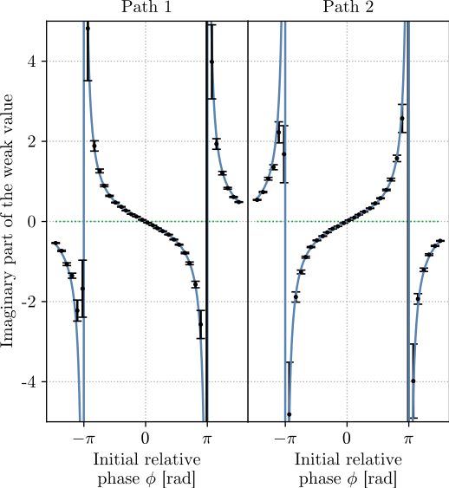
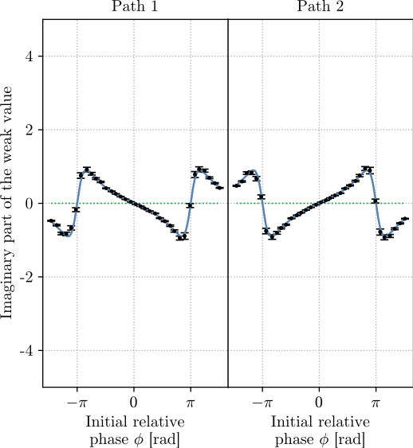
Weak values from output intensities
Balanced:
Unbalanced:

Slide 54
Weak values from output intensities
Blocker
Required setup:
Interferometer
Path blocker
Phase shifter
Measurements:
No meter state and no weak interaction (shorter acquisition times with comparable or improved precision)
3 measurements needed to completely determine the path weak-values

Slide 55
Weak values from output intensities
Bonus experimental result!
Three-path neutron interferometer:
3
2
1

Slide 56

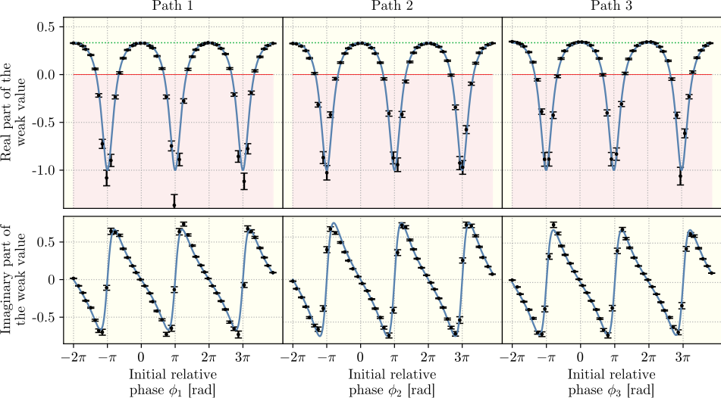
Weak values from output intensities
Initial state:

Slide 57
Summary
Quantum mechanics is nonclassical, but not always
Weak values can be used to identify nonclassical phenomena
Our group developed several methods to extract weak values in neutron interferometry
In particular, one method that requires no weak interaction and no meter state was presented. The method can be applied any N-level quantum system in which alike measurements can be performed.

Slide 58
Neutron Interferometry Group
Yuji Hasegawa (Professor/supervisor)
Stephan Sponar (Professor)
Hartmut Lemmel (Instrument responsible)
Andreas Dvorak (PhD student)
Florian Engel (PhD student)
Kazuma Obigane (PhD student)

Slide 59
Thank you for your attention!

